Slide 1
Doing Money Differently +
Cclite2 SMS Demo

Slide 2
Doing Money Differently
Hugh Barnard
Bit of Bio here: https://www.horizon.ac.uk/working-with-the-mema-3-0-project/
This talk is based on a talk already given at LARC in 2019 and a tech one given at London Perl Workshop:
https://hughbarnard.org/doing-money-differently/
All the new slides will go on my website, so don’t worry about making notes for the references, at least. Hopefully 20 minutes for talk 10 minutes for questions.
HEALTH WARNING: This is a short talk so not deep or complete, either for money or Cclite2

Slide 3
Outline of Talk
Talk is divided into two parts:
Skip through types of conventional money, manifestations and problems
Some of the alternatives and complementary type of ‘money’ + directions/innovations
What we’re up to and (possible) demo of SMS on Cclite2: https://forestgatenorth.org/mobile-help for doc (will complain about the cert but I look honest don’t I?)

Slide 4
Orthodox Money
Monetary orthodoxy has four functions of money:
Measure of value : The value (! see digression) of something is measured in a specific currency as units
Medium of exchange: Widely accepted token which can be exchanged for goods and services
Deferred Payment: It is the function of being a widely accepted way to value a debt
Store of value : A store of value is the function of an asset that can be saved retrieved and exchanged at a later time and be predictably useful when retrieved.
Other visions: See Graeber (especially on birth of credit vs barter), Gessell (demmurage), CH Douglas (mutual social credit) too.

Slide 5
Types of Money
Commodity backed: tokens can be exchanged with the issuer for gold, compost (yes! Bangkok project), energy etc. I haven't done 'pure commodity' gold coins, large round stones etc. Clearly some arguments about utility of the base commodity, can’t eat gold.
Pure fiat: This is money because 'we (! who we?) say it is' (enforced by state violence, if you want to be extreme)
Fiduciary Money: The value of a fiduciary currency depends on the confidence that it will be generally accepted as a medium of exchange. Unlike fiat currency, it is not declared legal tender by the government, which means people are not required by law to accept it as a means of payment, cheques, if you remember those?
Commercial Bank Money: Money issued as debt bearing by commercial banks. This is about 97% of issuance in the UK hence a huge democratic deficit. One could roll that up into the fiat category because it arrives out of 'nowhere'.
Tokens: Limited in scope, remember book tokens, supermarket points etc.

Slide 6
Digression
Philosophically there's a lot of difficulty about the nature of money, for example see: Social ontology of money (Stanford Encylopedia): https://plato.stanford.edu/entries/money-finance/
See also value theory: https://plato.stanford.edu/entries/value-theory/ I'm with Amartya Sen value doesn't look like this {1}, it looks more like this {1,16,eggs,53,nice-colour)
I'm also taking the view of a 'humane technologist' here. That we can design money-something(s) that give us better results for a wider population or revisit existing money-somethings.
So my view is somewhat artifactual, 'we' (who we?) (or the state, for example) made it up and we can make it up again
We never step back and think about, it’s like old wallpaper that we got used to. In the case of my home, the carpet.

Slide 7
Other Expressions of ‘Money’
More precisely these are mechanisms of exchange in some cases:
Local and regional currencies (Brixton Pound etc.), backed/unbacked convertible to national/or not
Cryptocurrencies (ugh!)
Specialised, (Loyalty points), Wellness, Torekes, a whole new talk in itself
Timebanks (basically propping up charities and usually require a lot of conventional finance)
Regional and business exchanges (SARDEX Sardinia, WIR Switzerland, Red Global de Trueque (RGT) Argentina)
Mutual social credit, LETs and related, this is the area where I concentrate

Slide 8
Let’s Analyse
Let’s put some of these on the couch:
Locals and regionals (Brixton, Totnes, both failed) are probably fiduciary since they can be changed back into national currency. Cryptos too?
Specialised tokens usually have limited purchasing power, flights, hotels etc.
Timebanks could be considered as locked down mutual social credit (hours, enforced equality) oriented towards ‘volunteers’ within ‘charities’ (Tempo, for example)
Sardex/WIR business to business networks and currencies: https://www.ft.com/content/cf875d9a-5be6-11e5-a28b-50226830d644 Successful.
Mutual social credit and LETS. ‘Value’ created at point of activity (orthogonal but hybrids possible) Biggest is CES: https://www.community-exchange.org/home/cen-statistics/
Let’s also note that all of these are complementary not alternative, they live alongside national currencies.

Slide 9
What does ‘success’ need?
Here are some partial ‘successes’:
Sardex: https://wiki.p2pfoundation.net/Sardex
WIR: https://en.wikipedia.org/wiki/WIR_Bank
Ithaca Hours (1990s-2010 but now defunct) https://en.wikipedia.org/wiki/Ithaca_Hours
Worgl (much examined by academia):https://en.wikipedia.org/wiki/W%C3%B6rgl#The_W%C3%B6rgl_Experiment

Slide 10
A few things that ‘help’ towards ‘success’
Business credit clearing seems to ‘work’
Valid for local taxes (Worgl, Bristol) sometimes works
Economic depression and ‘scarce’ national money
Convenience, as convenient as national? NFC, SMS, Web, Apps (ugh!)

Slide 11
Infrastructure, Innovation, and the Future
Why do the ‘pounds’ (and other systems) fail so often?
Limited offer for software (some renewal taking place, CES Rewrite (?), my own, Taler: https://www.taler.net/en/ngi-taler.html)
Equivalent convenience to national currencies and ‘contactless’, low friction
Alternative energy backed currencies
Maslow mix within groups, usually plenty of crystal healers, no plumbers
Goverment and Institution ambivalence: loss of control (timebanks)

Slide 12
Over to You
There’s space in the UK for thinking/acting in this space, even if it’s less sexy than AI. Better get there before Central Bank Digital Currency (CBDC) Too
Using the middle ground between neighbours and strangers: Boroughs/Areas?
Physical space required: the ‘head office’/community space, lesson of Stratford timebank
Tech innovation: Making (double coincidence of wants?) matching better, reducing transactional friction, reliable/simple infrastructure
Give it a spin: 07356 234041 and https://forestgatenorth.org/mobile-help (ignore complaints about the cert, the set up is a bit ‘provisional’.

Slide 13
Endpiece Money: Thank You!
“...you and Harlow were shipwrecked on a desert island, and you saved nothing from the wreck but a bag containing a thousand sovereigns, and he had a tin of biscuits and a bottle of water...Who would be the richer man you or Harlow?” (From Robert Tressell’s The Ragged Trousered Philanthropists

Slide 14
How Cclite Started: 1998 -2007
What is it all about: https://en.wikipedia.org/wiki/Local_currency
1998: The Encylopedia of Social Inventions
2003: Michael Linton in London
2005: Vague Beginnings: Linton, Lietaer, Fee, Walsh, Limehouse
2005: WSFII and the Lime
2007: First Versions of Cclite (the first one): https://sourceforge.net/projects/cclite/

Slide 15
The Middle Bit: 2007 - 2014
Community Currency Summer (Totnes, Brixton, Bristol)
LETS groups and systems
Currency controversies and Currency design
Community Currency winter (failure of Totnes, Brixton and Bristol)
Stagnation of LETs

Slide 16
Cclite2: Musings and Design Choices
Second system effect. Cclite had (github, sourceforge) about 10k downloads, but only tens of installs/groups using. Bit rot and old tech beckons
Stagnation of LETs
Modern world is multimodal, screens, phones, sms (and currently NFC see later)
Cclite was/is multilingual, this was to be maintained/improved
An engine as well as an application with visible interfaces (API accessible)
Some Cclite code and ideas ported forwards, especially DB work
Mobile HTML templates

Slide 17
Mojolicious Arrives
First release in 2008, good levels of maturity in 2010 approx
I’d worked with Catalyst (Lovefilm, BBC?) and wanted something ‘a little more’ than Dancer, less than Catalyst
Cpan still has ‘libraries for everything’

Slide 18
Template organisation
All the main folders are html, mobile and text, I’ve chosen to open the text because there are ‘only’ three languages currently, in total about 18 possible in the others
How to translate? Cclite (original) big ugly (my fault) parser based on HTML::TokeParser and (boo!) Azure translate
Now Python html.parser and Deepl translate, 160 approx lines. Experimenting with Libretranslate to be completely open but not quite ‘there’.

Slide 19
Postgres + DBIX for data
Schema roughly from old application Mariadb database: some ideas from 1998
SQLFairy + manual edits → Postgres schema
DBIx::Class::Schema::Loader to make the Perl modules
Wrangling! Not a DB person, not a Postgresql person

Slide 20
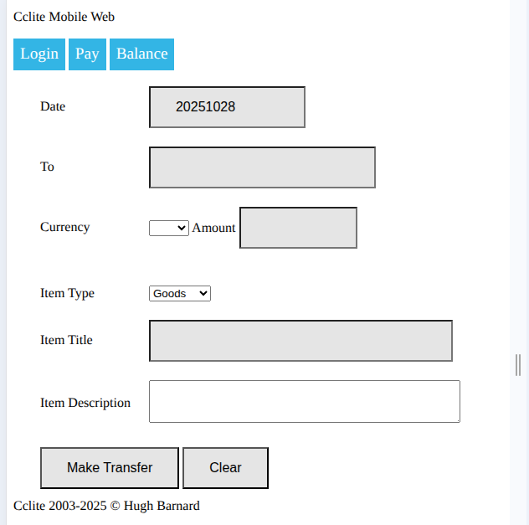
Now: Example Mobile Template
Wireframe mobile template, no ‘apps’: detect via browser string

Slide 21
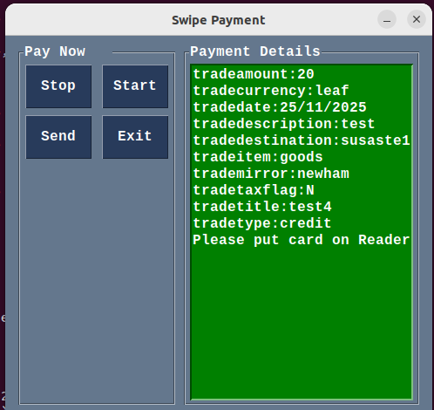
Work in Progress
NFC via ACR1252
Waiting for general mobile browser NFC
Crude HTTP handshakes with Mojolicious router at present: # FIXME: these need to be under the /api with jwt tokens? Get working first!
$r->post('/present/payme')->to('cclite#pay_me', {'object' => 'payme'});
Python smartcard library etc.

Slide 22
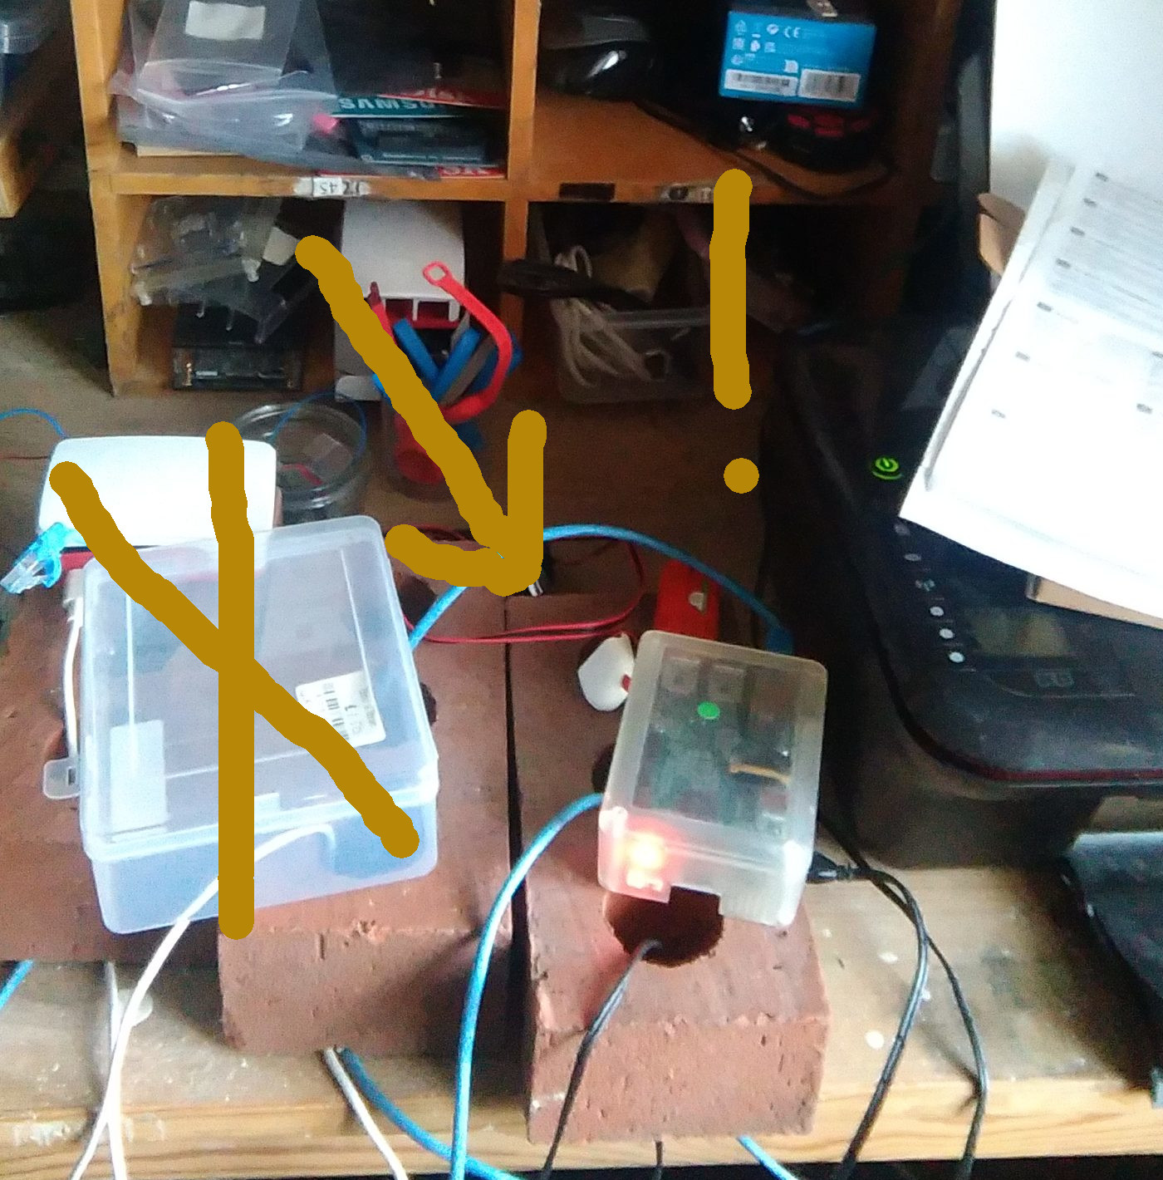
Here’s the Test Server
One on the right
Raspberry Pi 4B

Slide 23
The ‘learnings’ (ugh, aka lessons)/future
Currency/currency design, controversy, feeds into technical design, demmurage, sms sponsorship etc., relationship to nationals/’backed by’ concepts
Multilingual from outset, so second language folks can more easily mess around with it
Convenience (mobile/sms/web/nfc + short sequences), reaching down to use
Want an ‘easy’ core install, currently experimental: sudo apt install
Some pivoting from cpan towards apt perl-xxx but...
#Permacomputing/reduced ambition/pure ‘open’
Documentation badly behind, cclite had/has a manual
Why do this at all? It’s quixotic isn’t it?! (non funded/grant supported demonstrators, for example)

Slide 24
That’s all folks.
Thanks!
Here’s the (as usual almost) current code: https://sourceforge.net/p/cclite2/code/ci/master/tree/
hugh.barnard@protonmail.com and https://hughbarnard.org
https://big-wave-heuristics.com too...

